Slide 1
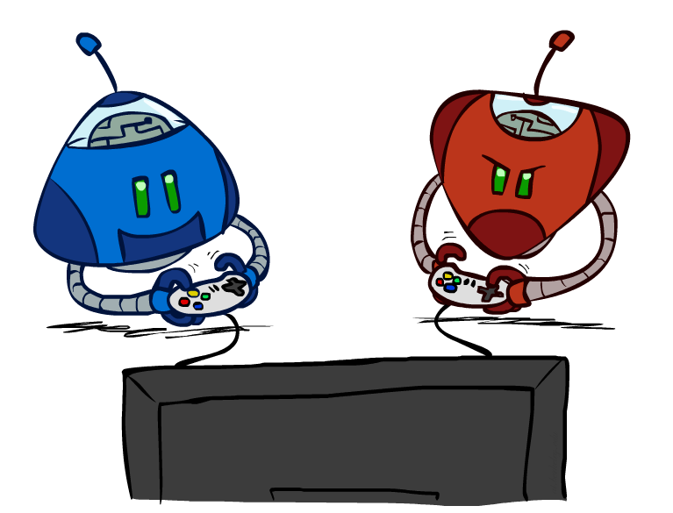
Adversarial Search
MINIMAX Search

Slide 2
MAEs and Games
Multi-agent environment: every agent needs to consider the actions of the other agents, in order to optimize its own welfare
  Cooperative:
    Agents act collectively to achieve a common goal
  Competitive:
    Agents compete against each other
    Their goals are in conflict
    Gives rise to the concept of adversarial search problems – often known as games.

Slide 3
Games vs. Search problems
In typical search problems, we optimize a measure to acquire the goal: there is no opponent
In games, there is an "Unpredictable" opponent
  Need to specify a move for every possible opponent reply
  Strict penalty on an inefficient move
  Stringent time constraints
  Unlikely to find goal, must approximate
  Requires some type of a decision to move the search forward.

Slide 4
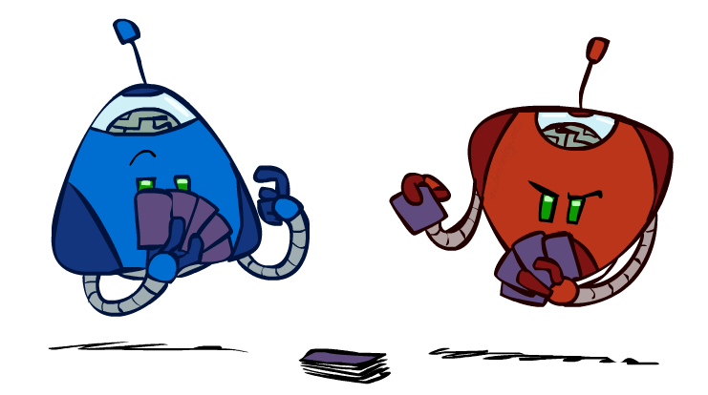
Types of Games
Many different kinds of games!
Axes:
  Deterministic or stochastic?
  One, two, or more players?
  Zero sum?
  Perfect information (can you see the state)?
Want algorithms for calculating a strategy (policy) which recommends a move from each state

Slide 5
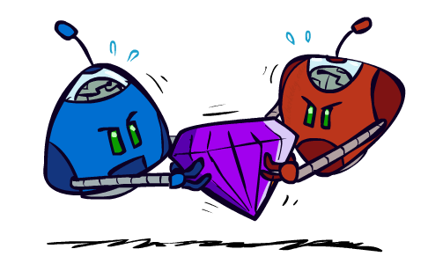
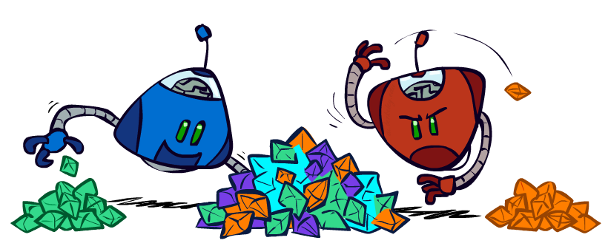
Zero-Sum Games
Zero-Sum Games
  Agents have opposite utilities (values on outcomes)
  Lets us think of a single value that one maximizes and the other minimizes
  Adversarial, pure competition
General Games
  Agents have independent utilities (values on outcomes)
  Cooperation, indifference, competition, and more are all possible
  More later on non-zero-sum games

Slide 6
Game Formulation
States: S (start at Initial State s₀)
Players: P={1...N} (usually take turns)
Actions: A (may depend on player / state)
Transition Function: SxA → S
Terminal State Test: S → {t,f}
Terminal Utilities: SxP → R
  defining the usefulness of the terminal states from the point of view of one of the players.

Slide 7
Basic Strategy
Grow a search tree – and examines enough nodes to allow a player to determine what move to make.
Only one player can make move at each turn.
Assume we can assign a payoff (utility value) at final position.
Assume opponent always makes moves worst for us.
Pick best move on own turn.

Slide 8
Utility function
For Tic-Tac-Toe, the function could be as simple as returning:
  +1/ +C (+10); it means that MAX wins
  -1/ -C (-10); it means that MIN wins
  0 otherwise.
However, this simple evaluation function may require deeper search
Complete tree needs to be generated to calculate moves
  May be slow/infeasible in some cases!

Slide 9
Optimal Strategy For MAX
This is a Multi Agent Environment
  In discovering the sequence of optimal moves by MAX, we have to consider that MIN is taking moves as well
  So, the optimal strategy will tell how should MAX play against MIN (by considering the moves of the latter), in order to win the game
Let us consider a shortened game tree of TIC-TAC-TOE
  Numbers are the utilities
  Ply: a move by MAX followed by a move from MIN.

Slide 10
Minimax
When it is the turn of MAX, it will always take an action in order to maximize its utility, because it’s winning configurations have high utilities
When it is the turn of MIN, it will always take an action in order to minimize its utility, because it’s winning configurations have low utilities
In order to implement this, we need to define a measure in each state that takes the move of the opponent into account.
The term “MINIMAX” is used because:
  the opponent is always trying to minimize the utility of the player, and
  the player is always trying to maximize this minimized selection of the opponent.

Slide 11
Adversarial Search (Minimax)
Minimax values:
computed recursively
Deterministic, zero-sum games:
  Tic-tac-toe, chess, checkers
  One player maximizes result
  The other minimizes result
Minimax search:
  A state-space search tree
  Players alternate turns
  Compute each node’s minimax value: the best achievable utility against a rational (optimal) adversary
5
max
2
5
min
8
2
5
6
Terminal values:
part of the game

Slide 12
Minimax Example
3
12
8
2
4
6
14
5
2
At each node, MAX will always select the action with highest minimax value (it wants to reach states with higher utilities)
At each node, MIN will always select the action with lowest minimax value (it wants to reach states with lower utilities).

Slide 13
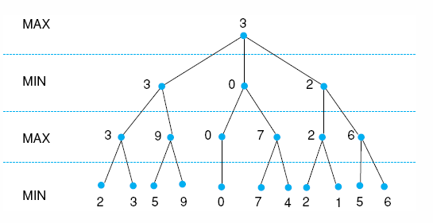
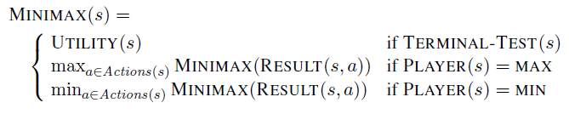
Minimax to a hypothetical state space. Leaf states show heuristic values; internal states show backed-up values.
Notes:
Insert fig 4.21

Slide 14
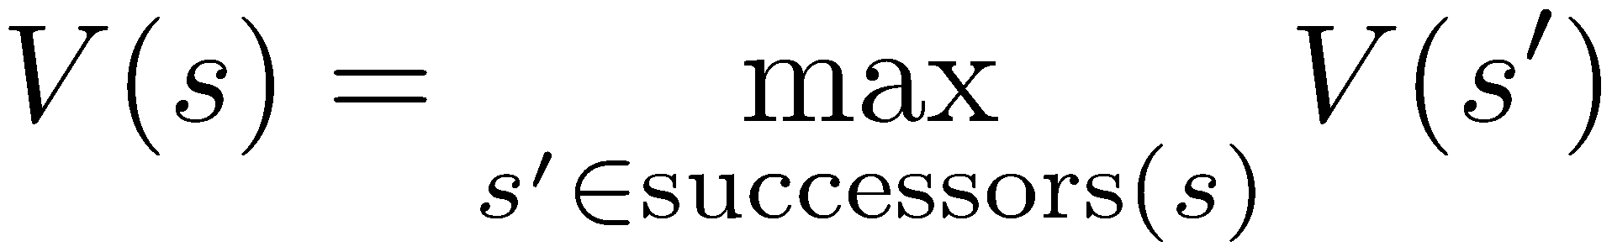
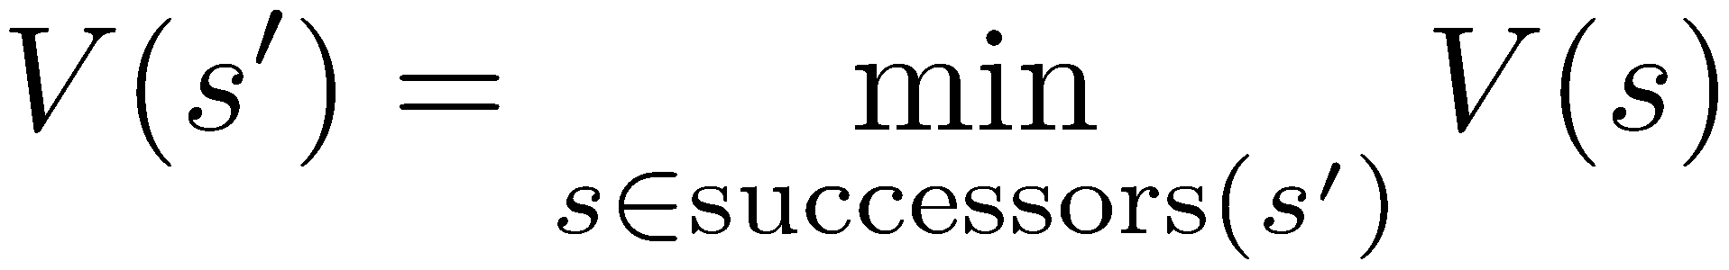
Minimax Implementation (Dispatch)
def value(state):
  if the state is a terminal state: return the state’s utility
  if the next agent is MAX: return max-value(state)
  if the next agent is MIN: return min-value(state)
def max-value(state):
  initialize v = -∞
  for each successor of state:
    v = max(v, value(successor))
  return v
def min-value(state):
  initialize v = +∞
  for each successor of state:
    v = min(v, value(successor))
  return v
Notes:
Pick an order for two reasons: sequential processor and pruning

Slide 15
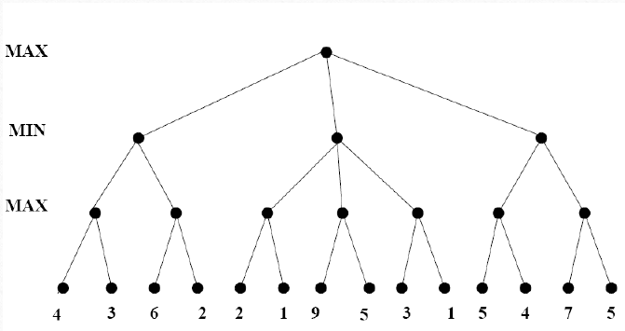

Slide 16
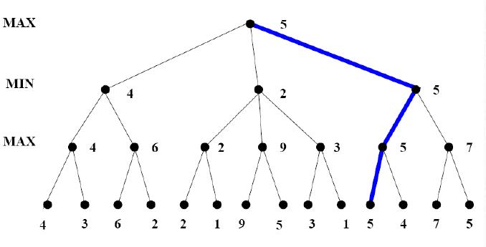

Slide 17
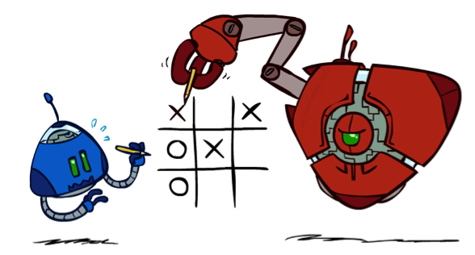
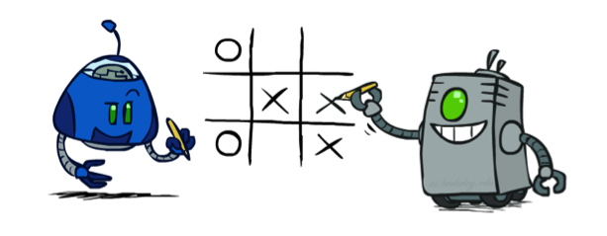
Minimax Properties
max
min
10
10
9
100
Optimal against a perfect player. Otherwise?

Slide 18
Perhaps a better utility function?
+100 for EACH 3-in-a-line for computer (Max).
+10 for EACH 2-in-a-line (with a empty cell) for computer.
+1 for EACH 1-in-a-line (with two empty cells) for computer.
Same negative scores for opponent (Min),
  -100 for EACH 3-in-a-line
  -10 for EACH 2-in-a-line
  -1 for EACH 1-in-a-line.
0 otherwise (empty lines or lines with both computer's and opponent's seed).
Compute the scores for each of the 8 lines (3 rows, 3 columns and 2 diagonals) and obtain the sum.

Slide 19
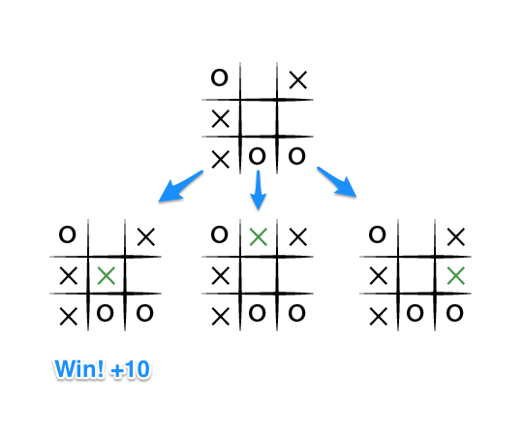
Brief Example

Slide 20
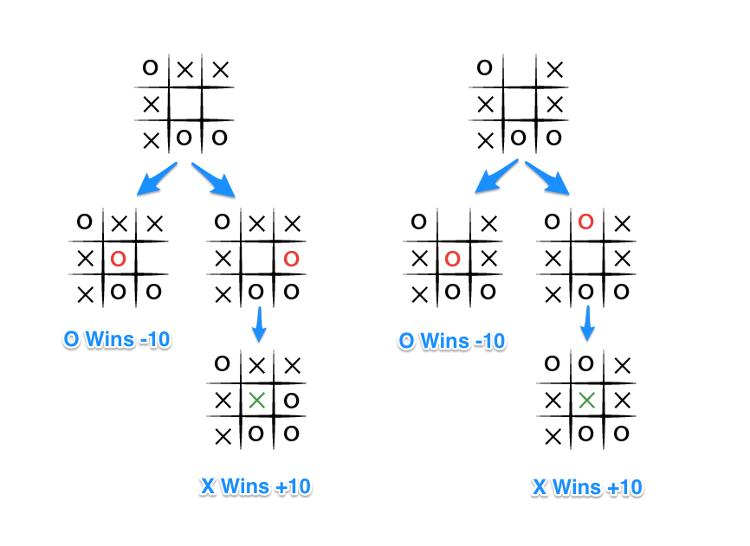

Slide 21
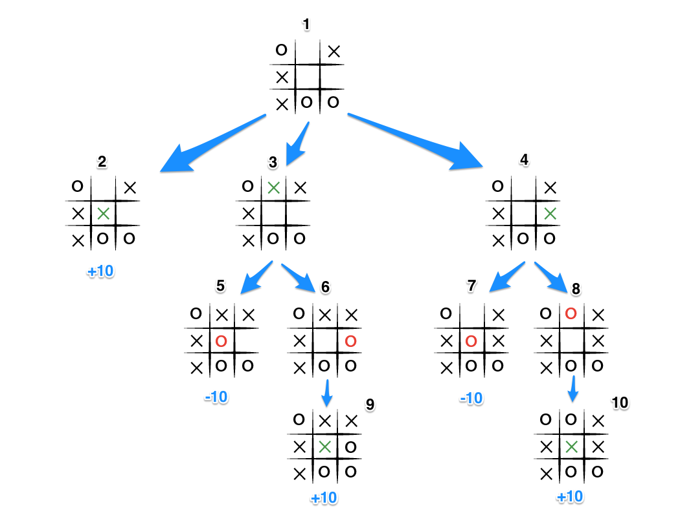

Slide 22
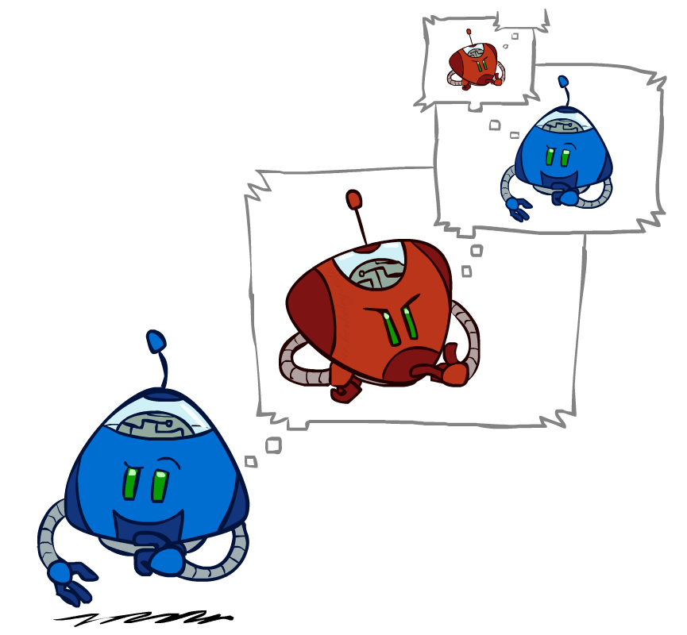
Minimax Efficiency
How efficient is minimax?
  Just like (exhaustive) DFS
  Time: O(b^{m})
  Space: O(bm)
  Complete: Yes (if tree is finite)
  Optimal? Yes (against an optimal opponent)

Slide 23
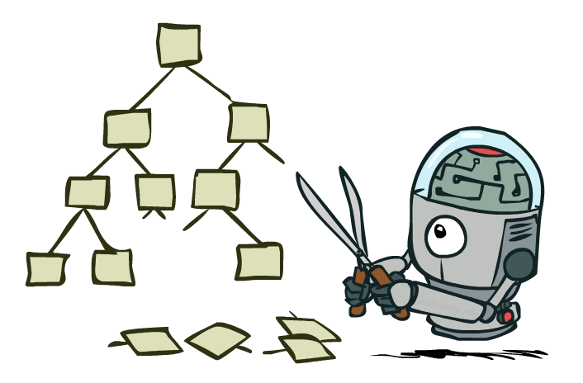
Game Tree Pruning

Slide 24
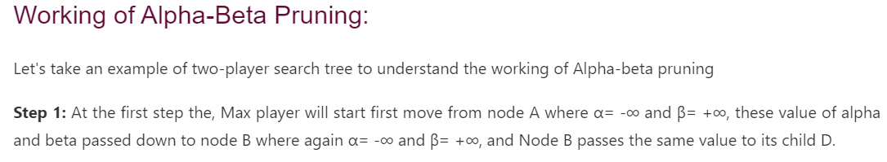
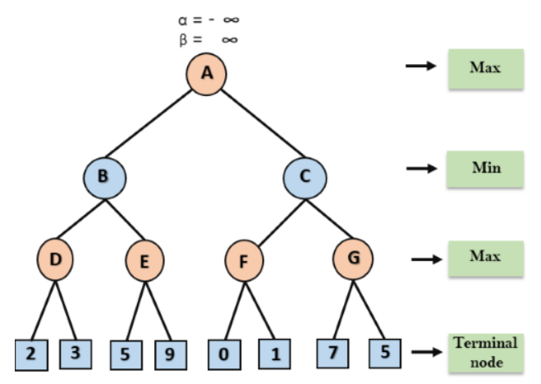

Slide 25
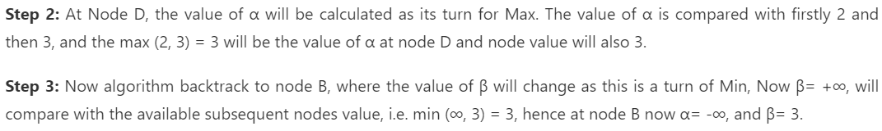
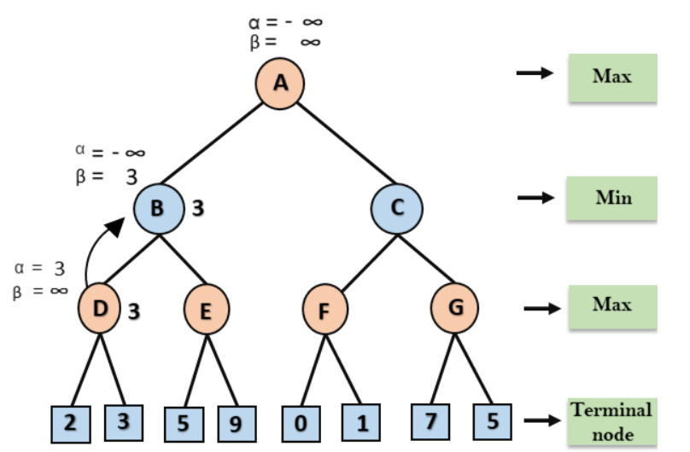

Slide 26
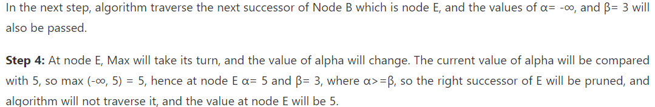
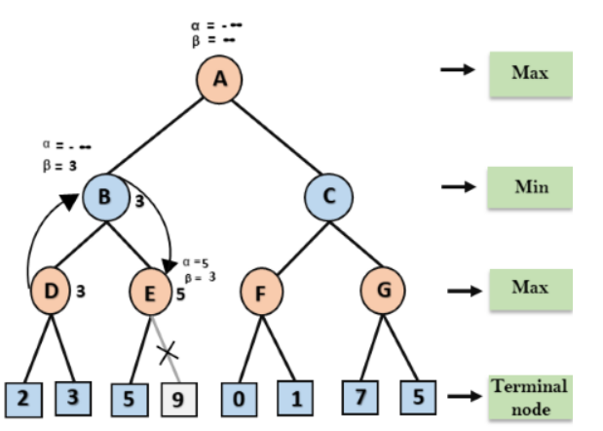

Slide 27
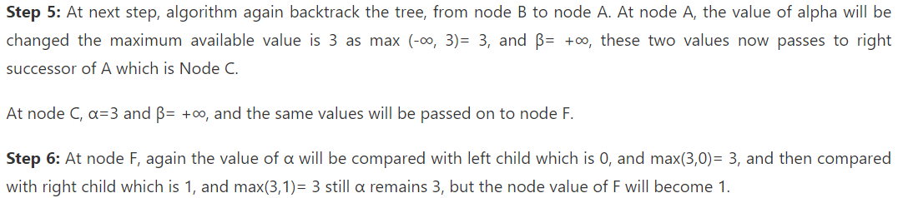
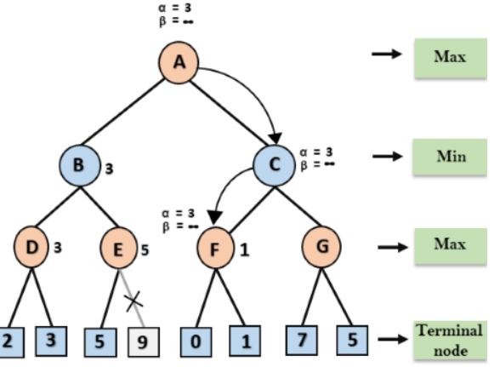

Slide 28
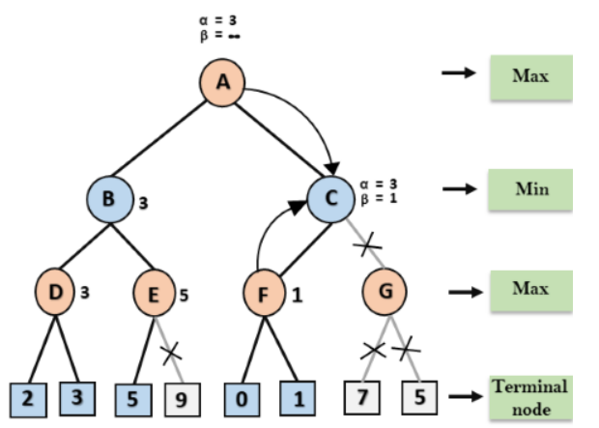

Slide 29
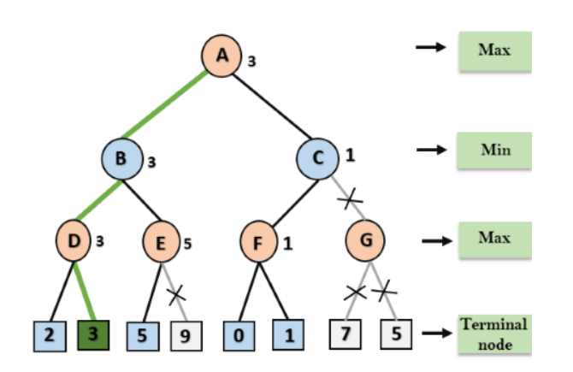

Slide 30
Minimax Search
Straight minimax requires a two-pass analysis of the search space,
  the first to descend to the level depth and
  the second to propagate values back up the tree.
Minimax pursues all branches in the space, including many that could be ignored or pruned by a more intelligent algorithm.
Recursion: Winds all the way to the terminal nodes, and then unwinds back by backing up the values
Time complexity:
Worst Case O(b^d) No pruning (same as Minimax)
Best Case O(b^(d/2)) Perfect move ordering → maximum pruning
Space Complexity: O(bd)

Slide 31
Minimax Example
3
12
8
2
4
6
14
5
2

Slide 32
Minimax Pruning
3
12
8
2
14
5
2

Slide 33
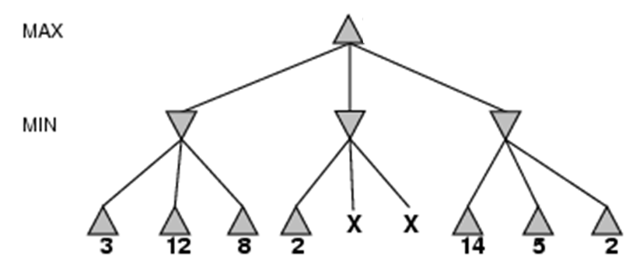
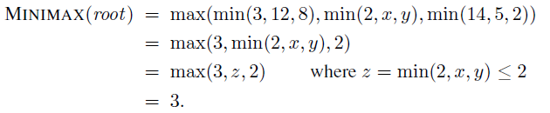

Slide 34
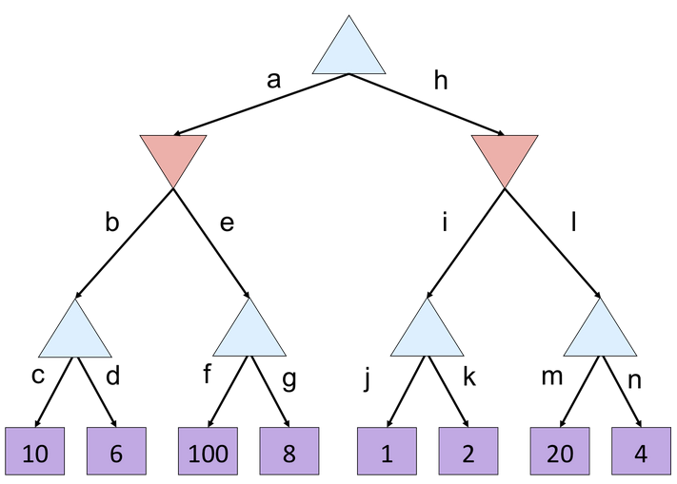
Minimax Activity Q1
What is the value of the top node?
A) 10
B) 100
C) 2
D) 4

Slide 35
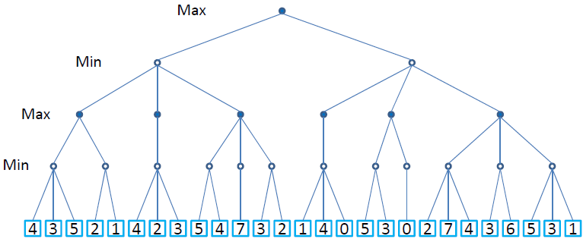
Minimax: Activity Q2
Perform the minimax algorithm on the figure below.

Slide 36
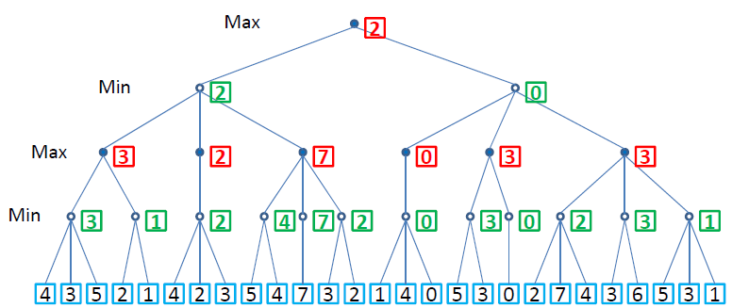
Minimax Search Activity Q3

Slide 37
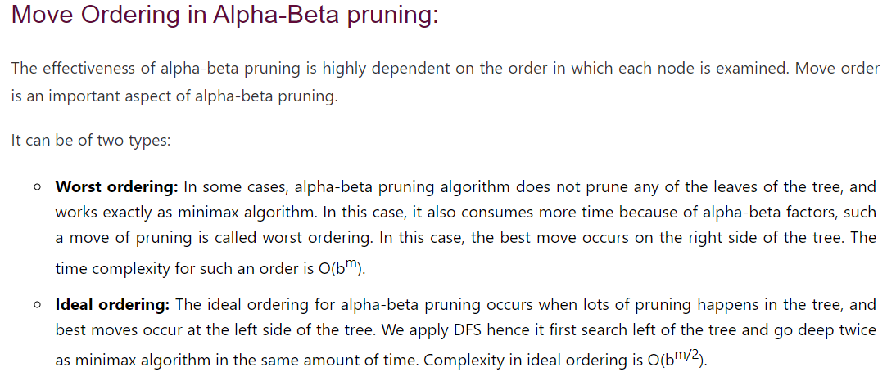

Slide 38
